Slide 1
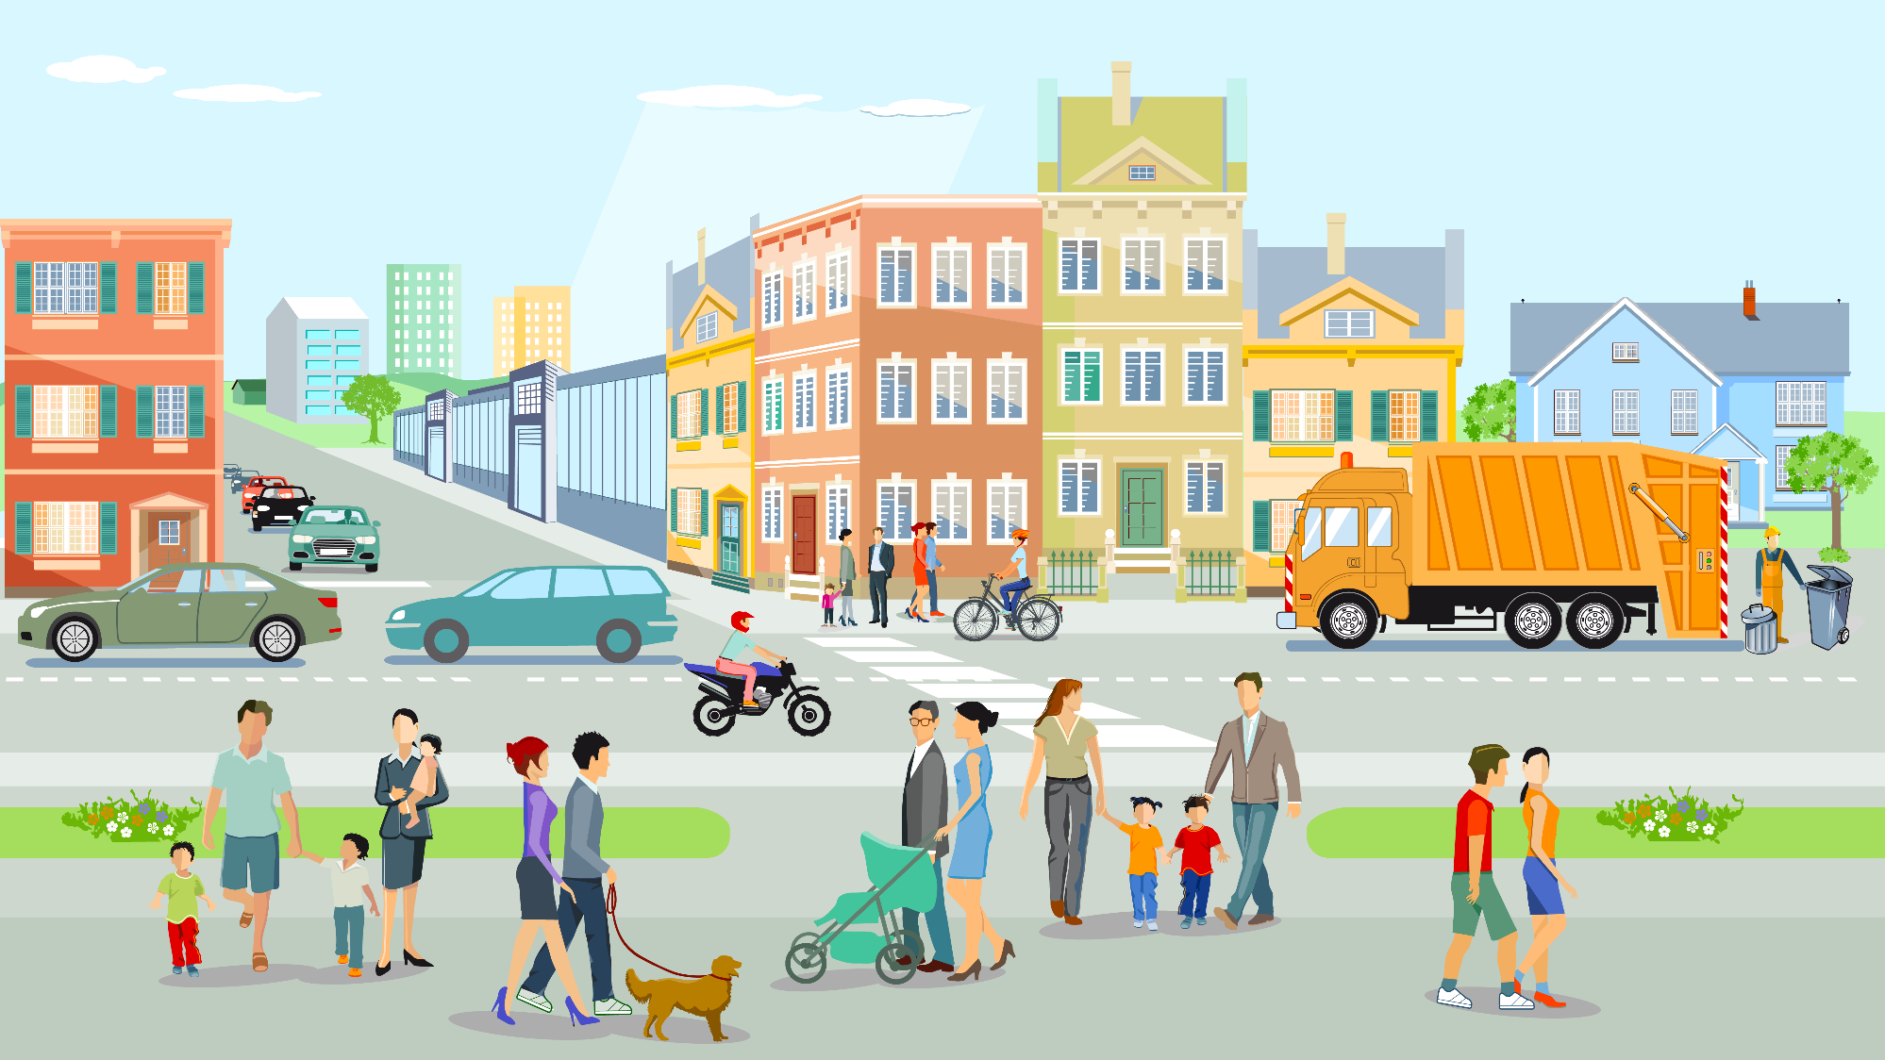
Dare them to Dream: Building Recovery Capital Step by Step
Developed by:
National Drug Court Institute
©All Rise, 2024
The following presentation may not be copied in whole or in part without the written permission of the author of the National Drug Court Institute. Written permission will generally be given upon request.
Notes:
Dream is defined as a cherished aspiration, ambition or ideal. When was the last time our clients dreamed? We want to introduce them to a lifestyle of recovery. In order to do this work, we have to help them dream. We will need to challenge them to step outside of what they see and build hope for the future. As we go through this presentation, I am going to share with you a poem by Wendy Silvia titled Dare to Dream. Let’s get started.

Slide 2
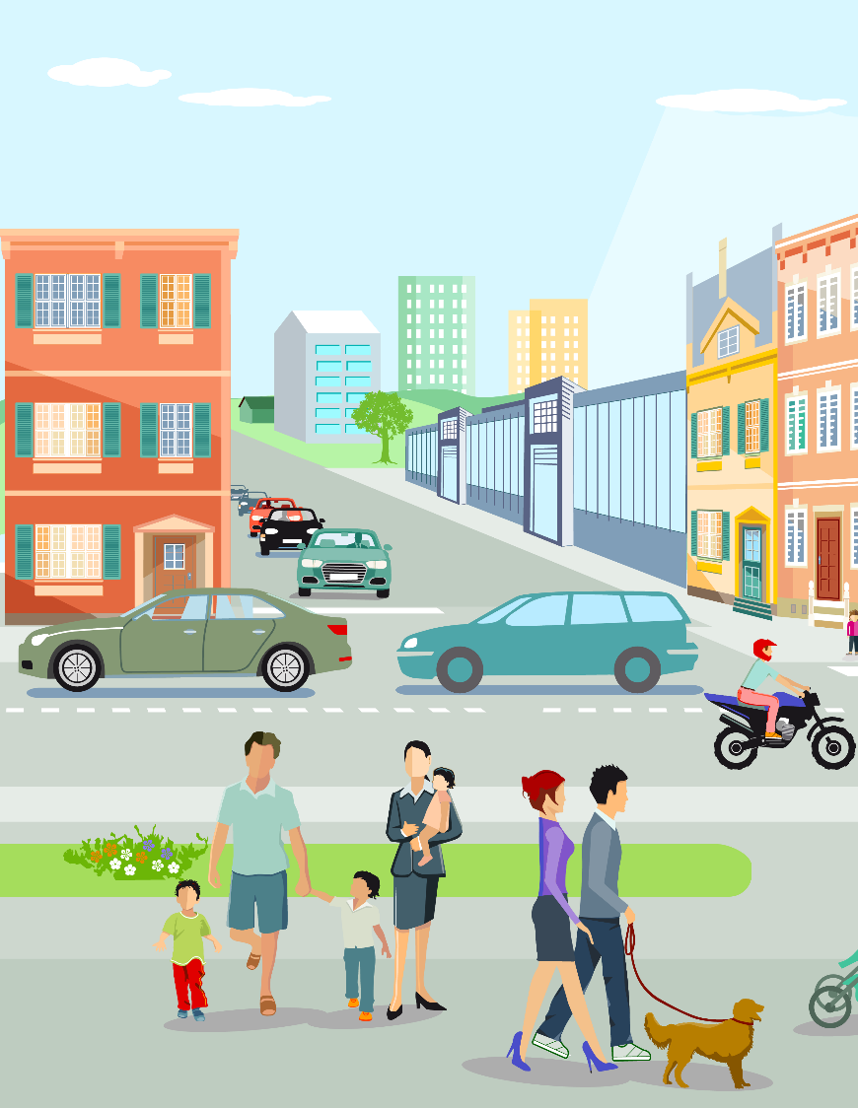
Distinction
Treatment
Recovery
In-or outpatient services
Detox
Group
Individual counseling
Medication assisted therapies
Choice
Personal
Value
Notes:
To begin this discussion, we first must address that there is a distinction between recovery and treatment. According to the Center for Substance Abuse Treatment (CSAT), "treatment" is defined as in- or outpatient services that focus on initiating and maintaining an individual’s recovery from alcohol or drug abuse and on preventing relapse. Treatment can include detoxification, group or individual counseling, rehabilitation and the use of methadone or other prescription medications.
Quite often, treatment is considered the "light at the end of the tunnel" for those afflicted with substance use disorders. Treatment is a positive process, involving a variety of support systems that systematically help lead individuals to successful, fulfilling lives without drugs and alcohol.
You can be compelled and required to do treatment. However, recovery is a choice. In order to assist the individuals entering our programs, we must understand this distinction.

Slide 3
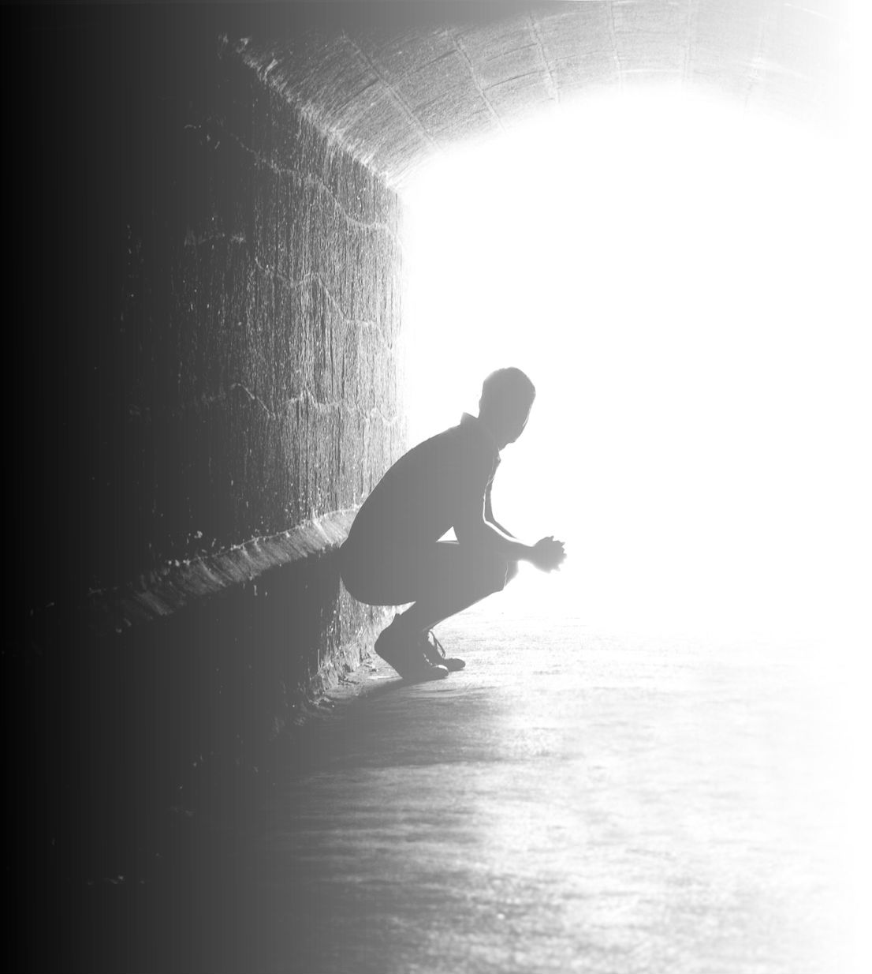
RECOVERY
Definition:
Recovery is a PROCESS of change through which individuals improve their health and wellness, live self-directed lives, and strive to reach their potential.

Slide 4
Understanding Recovery Capital
All the personal and tangible resources a person has and needs in order to initiate and sustain recovery (Granfield & Cloud, 1999; Laudet and Best, 2010; White & White, 2008).
Research is varied, but generally three to six elements of recovery capital:
Human
Financial
Social
Community
Cultural

Slide 5
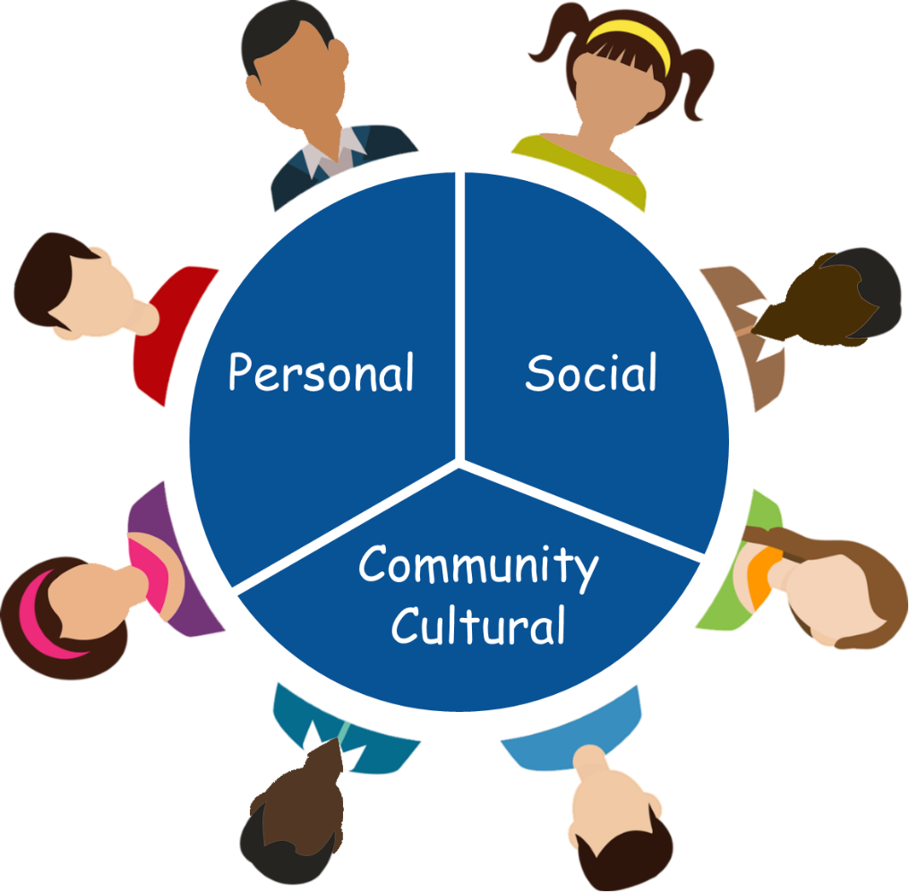
Recovery Capital
Notes:
From: White, W. & Cloud, W. (2008). Recovery capital: A primer for addictions professionals. Counselor, 9(5), 22-27.
Recovery Capital Defined
Recovery capital (RC) is the breadth and depth of internal and external resources that can be drawn upon to initiate and sustain recovery from severe AOD problems (Granfield & Cloud, 1999; Cloud & Granfield, 1 2004).
Recovery capital is conceptually linked to natural recovery, solution- focused therapy, strengths-based case management, recovery management, resilience and protective factors, and the ideas of hardiness, wellness, and global health. There are three types of recovery capital that can be influenced by addictions professionals.
Personal recovery capital can be divided into physical and human capital. A client’s physical recovery capital includes physical health, financial assets, health insurance, safe and recovery-conducive shelter, clothing, food, and access to transportation. Human recovery capital includes a client’s values, knowledge, educational/vocational skills and credentials, problem solving capacities, self-awareness, self-esteem, self- efficacy (self-confidence in managing high risk situations), hopefulness/optimism, perception of one’s past/present/future, sense of meaning and purpose in life, and interpersonal skills.
Family/social recovery capital encompasses intimate relationships, family and kinship relationships (defined here non-traditionally, i.e., family of choice), and social relationships that are supportive of recovery efforts. Family/social recovery capital is indicated by the willingness of intimate partners and family members to participate in treatment, the presence of others in recovery within the family and social network, access to sober outlets for sobriety-based fellowship/leisure, and relational connections to conventional institutions (school, workplace, church, and other mainstream community organizations).
Community recovery capital encompasses community attitudes/policies/resources related to addiction and recovery that promote the resolution of alcohol and other drug problems. Community recovery capital includes:
• active efforts to reduce addiction/recovery-related stigma,
• visible and diverse local recovery role models,
• a full continuum of addiction treatment resources,
• recovery mutual aid resources that are accessible and diverse,
• local recovery community support institutions (recovery centers /
clubhouses, treatment alumni associations, recovery homes, recovery
schools, recovery industries, recovery ministries/churches), and
• sources of sustained recovery support and early re-intervention (e.g., recovery checkups through treatment programs, employee assistance
programs, professional assistance programs, drug courts, or recovery community organizations).
2
Cultural capital is a form of community capital. It constitutes the local availability of culturally-prescribed pathways of recovery that resonate with particular individuals and families. Examples of such potential resonance include Native Americans recovering through the “Indianization of AA” or the “Red Road,” or African Americans recovering within a faith- based recovery ministry or within an Afrocentric therapeutic orientation (Coyhis & White, 2006; White & Sanders, in press).

Slide 6
Personal Capital
Divided into both physical and human capital
Human capital includes:
Values
Knowledge
Skills
Self-esteem
Risk management
Financial includes:
Transportation
Shelter
Access to insurance
Notes:
When we sit down with our clients ask them to do this work.
Close your eyes and let your imagination fly away. See a picture of where you wish to be one day.
Let the colors of your heart take command to paint the picture of your dream and place it in your hand.

Slide 7
Personal Capital
Personal Capital
Defined by:
Defined by:
Self-confidence
Motivation
Mental health
Physical health
Cognitive health
Education
Self-confidence
Motivation
Mental health
Physical health
Cognitive health
Education
Community Resource Examples:
Community Resource Examples:
SUD Treatment
Cognitive Behavioral Treatment
Medical access
Core correctional practices
Shelter
Transportation
SUD Treatment
Cognitive Behavioral Treatment
Medical access
Core correctional practices
Shelter
Transportation
Notes:
Internal resources – we have to help the clients rebuild these to see them selves up. Community resources help them to come out of the fog. It is active engagement with services, people to help reduce SUD and reduce stigma. We lend them hope until they have their own. This is why our messaging is important and the language we use. How we introduce them to community resources.

Slide 8
Social Capital
Relationships
Family
Friends
Supportive social relationships that are centered around recovery
Relational connections

Slide 9
Social Capital
Defined by:
Sober & supportive friends
Supportive/ structured family
Sober living environment
Participation in developmentally appropriate groups
Community Resource Examples:
AA/NA Sponsor
Running club
Recovery related social events

Slide 10
Community and Cultural Capital
Full continuum of treatment resources
Accessibility of resources that are diverse
Local recovery efforts and supports
Culturally prescribed and supported pathways of recovery
Recovery norms are valued in the community

Slide 11
Community/ Cultural Capital
Defined by:
Treatment court aware and able to link client to local opportunities:
Developmentally/ culturally appropriate recovery groups
Normative culture of sobriety
Personal culture
Community Resources Examples:
College recovery programs
Recovery ministry
Recovery-based social clubs
Notes:
Supports that enable the social connections. For example, having enough access to to AA/NA or recovery clubs. Accessibility/availability of all resources to create that social connection. If there is a strong presence in the community, will have reduced stigma.

Slide 12
Te
Team Needs
Defined by:
Integrated Case Management:
Self-confidence
Motivation
Mental health
Physical health
Cognitive health
Education
Written Plan
MI
Linkages
Build Rapport
Case Managers
Listening
Community Resource Examples:
Considerations:
SUD Treatment
Cognitive Behavioral Treatment
Medical access
Core correctional practices
Shelter
Transportation
Takes time
Use tools
Community
Short –time
Shelter
Transportation
Notes:
Internal resources

Slide 13
Acknowledgement
The Recovery Capital information per phase is taken from the Recovery Capital Scale by Robert Granfield and William Cloud.
Please check it out at: https://eipd.dcs.wisc.edu/non-credit/WI_Voices/Peer-Support-ED-Setting/story_content/external_files/Recovery%20Capital%20Scale-update.pdf
Notes:
You can download and use this tool with your clients in the early part of the program and at the end. It can also be used as a part of the Recovery Management Work with individuals to help them process their accomplishments.

Slide 14
High Risk and High Need
Notes:
As we begin to discuss implementing Recovery Capital with individuals. I want everyone to pause and reflect that this hard work for the individuals that we serve. I want us to Dare them to Dream. Walt Disney said if you can dream it, you can do it. George Elliot said it is never too late to be who you might have been. Help them dream. There are some of us in this room who came from humble beginnings, but you had a dream, you had a mentor, you had someone who believed in you and some of us just wanted to do better. Help the individuals in the program dig deep into themselves and accomplish achievements beyond their thoughts.

Slide 15
Phase 1
Recovery Capital
I have financial resources to provide for myself and family
I have a personal transportation or access to public transportation
I live in a home and neighborhood that is safe and secure
I live in an environment free from alcohol and other drugs
I have a primary care physician who attends to my health problems.
I have insurance that will allow me to receive help for major health problems.
I have access to regular, nutritious meals.
Notes:
Recovery is evidenced by personal and relational growth that affects all life domains. In phase I, we are focusing on Physical recovery capital includes such necessities as safe and recovery-focused housing, clothing, food, health insurance, and access to transportation.

Slide 16
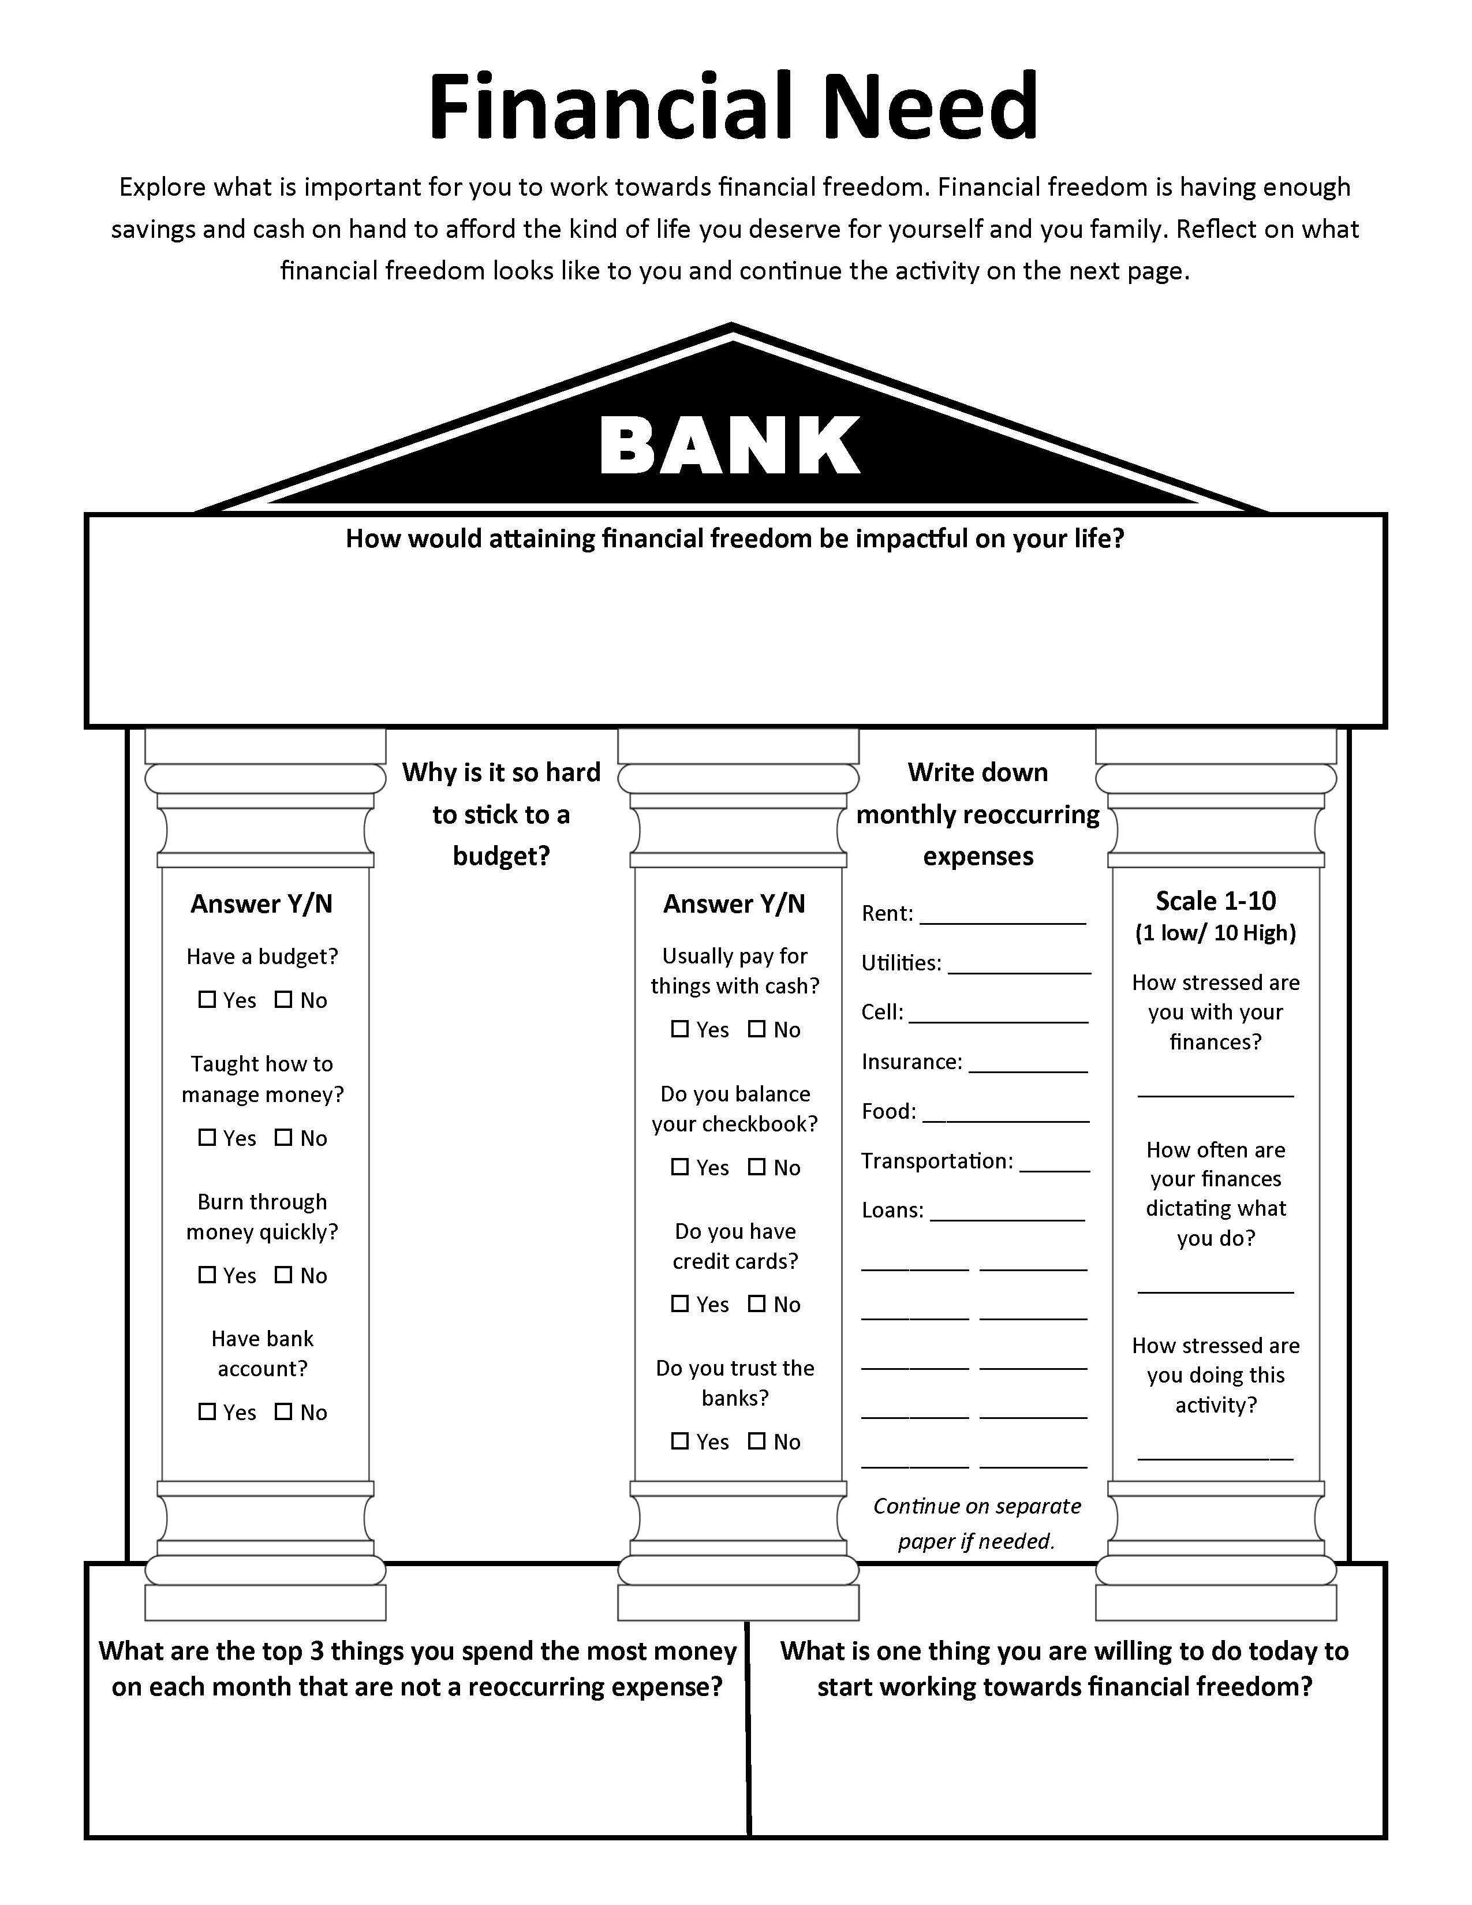

Slide 17
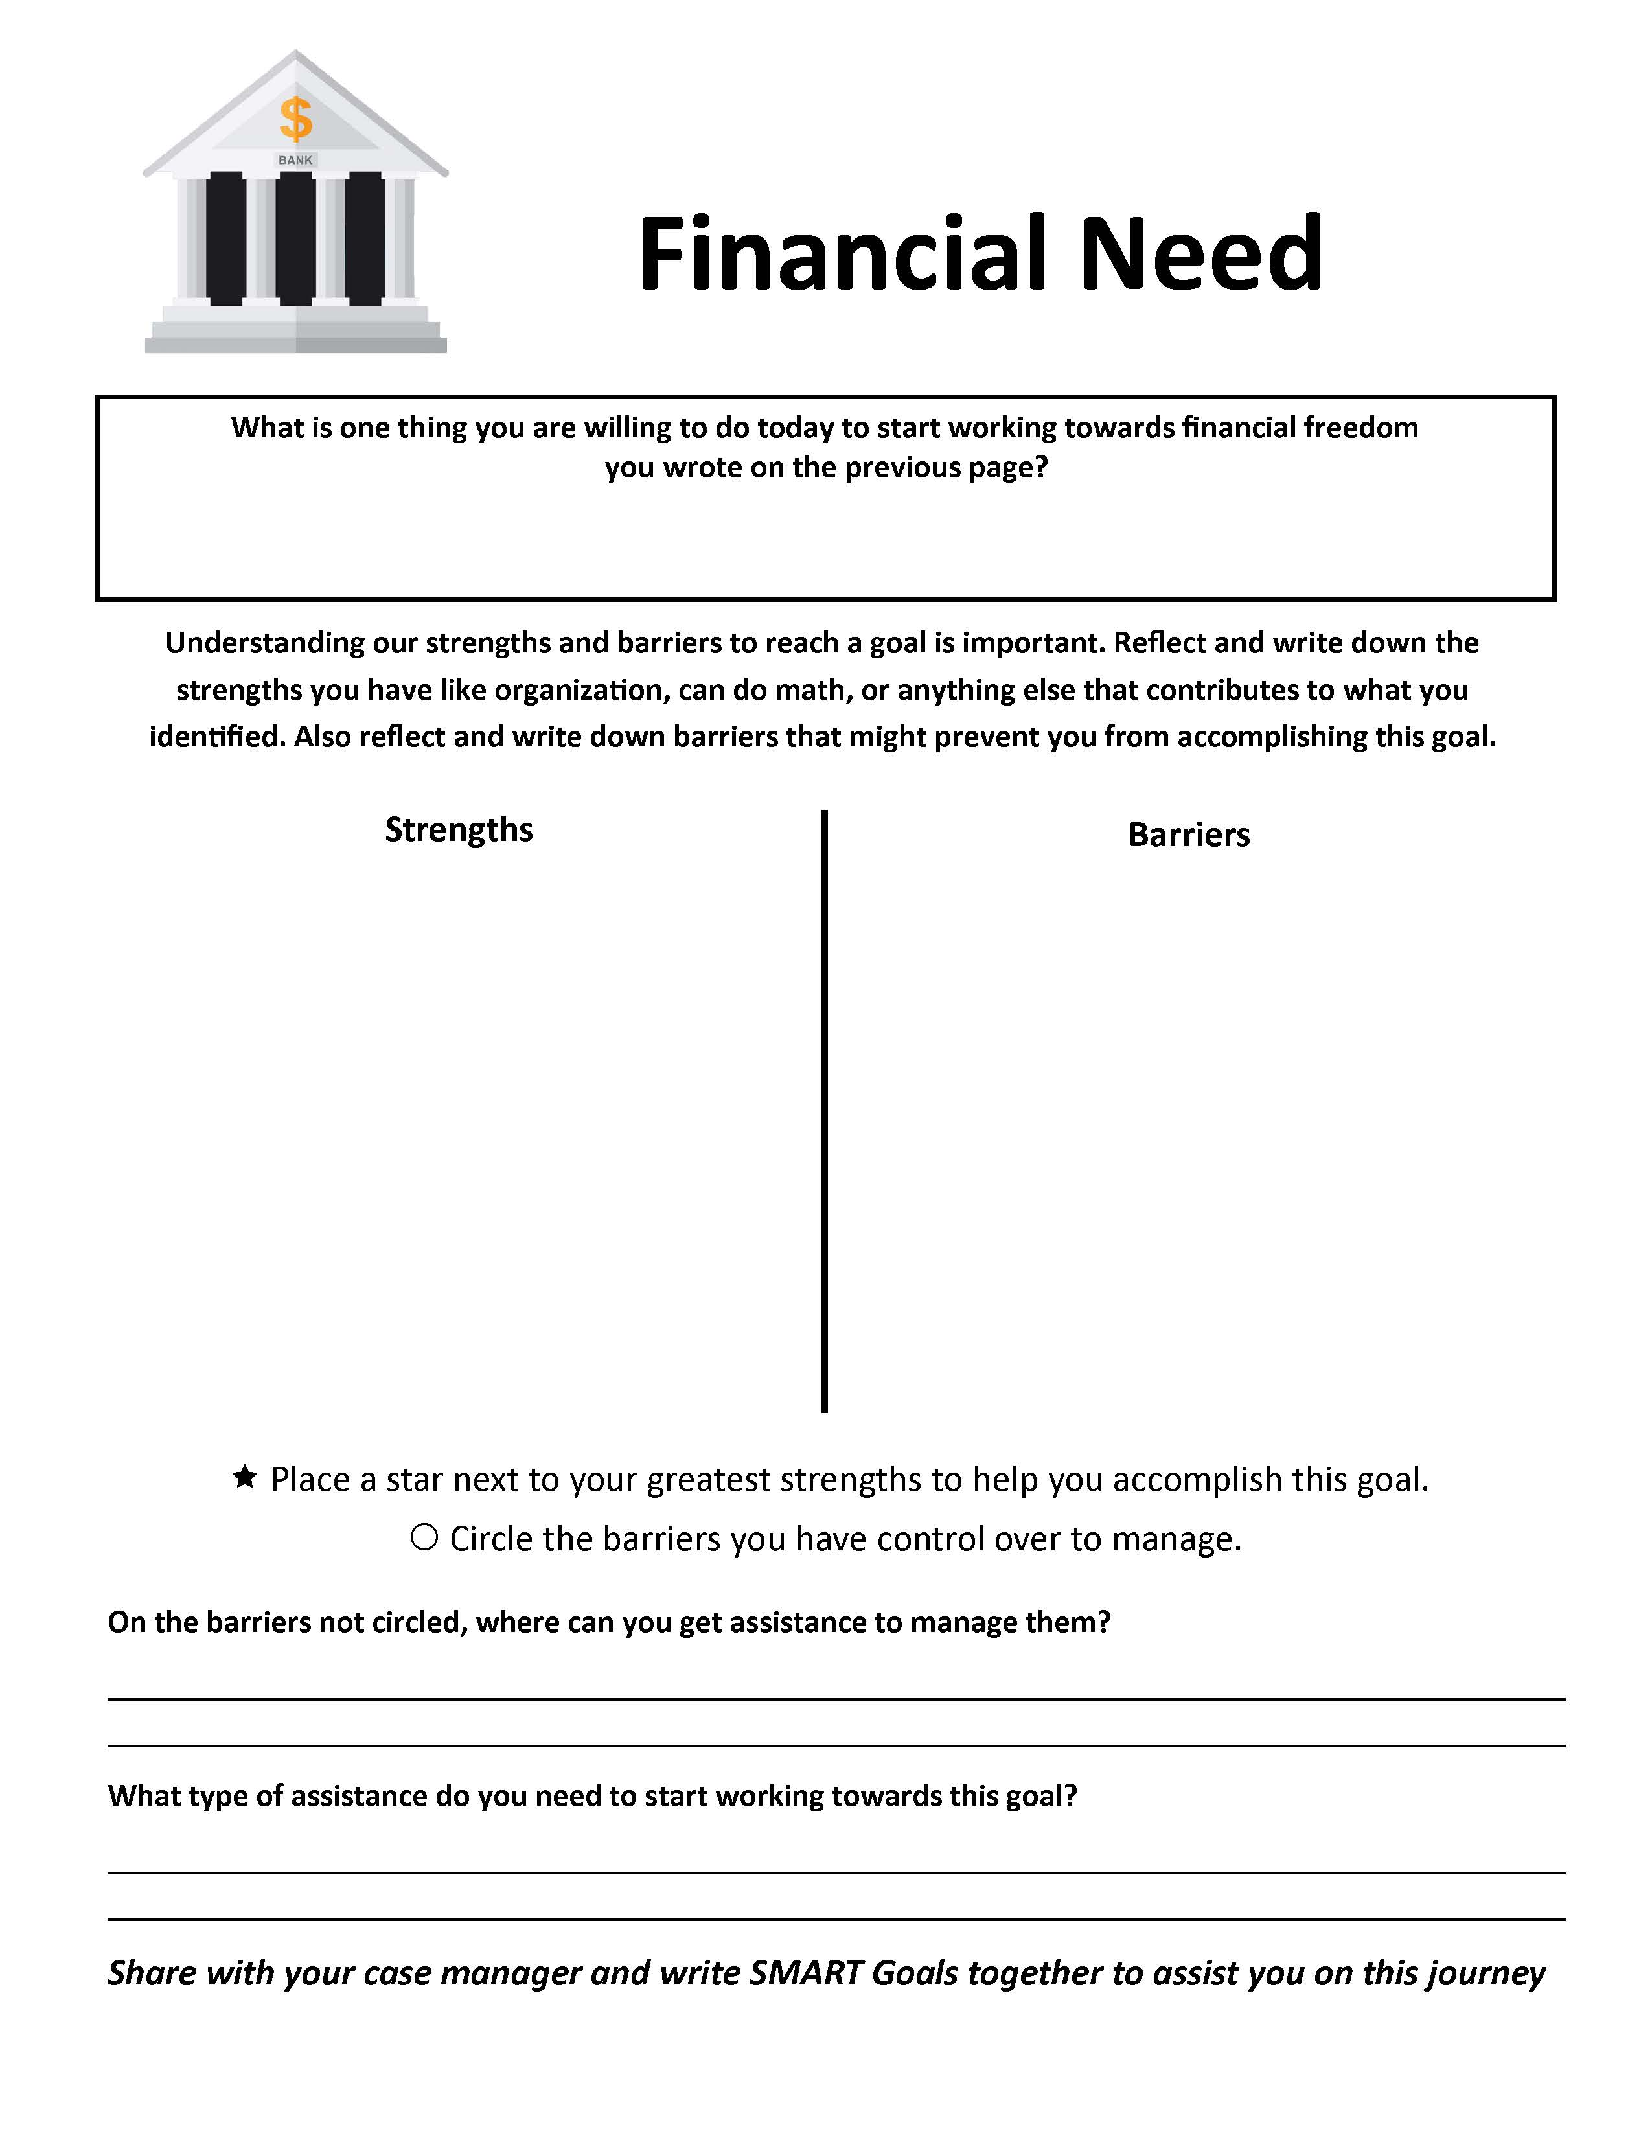

Slide 18
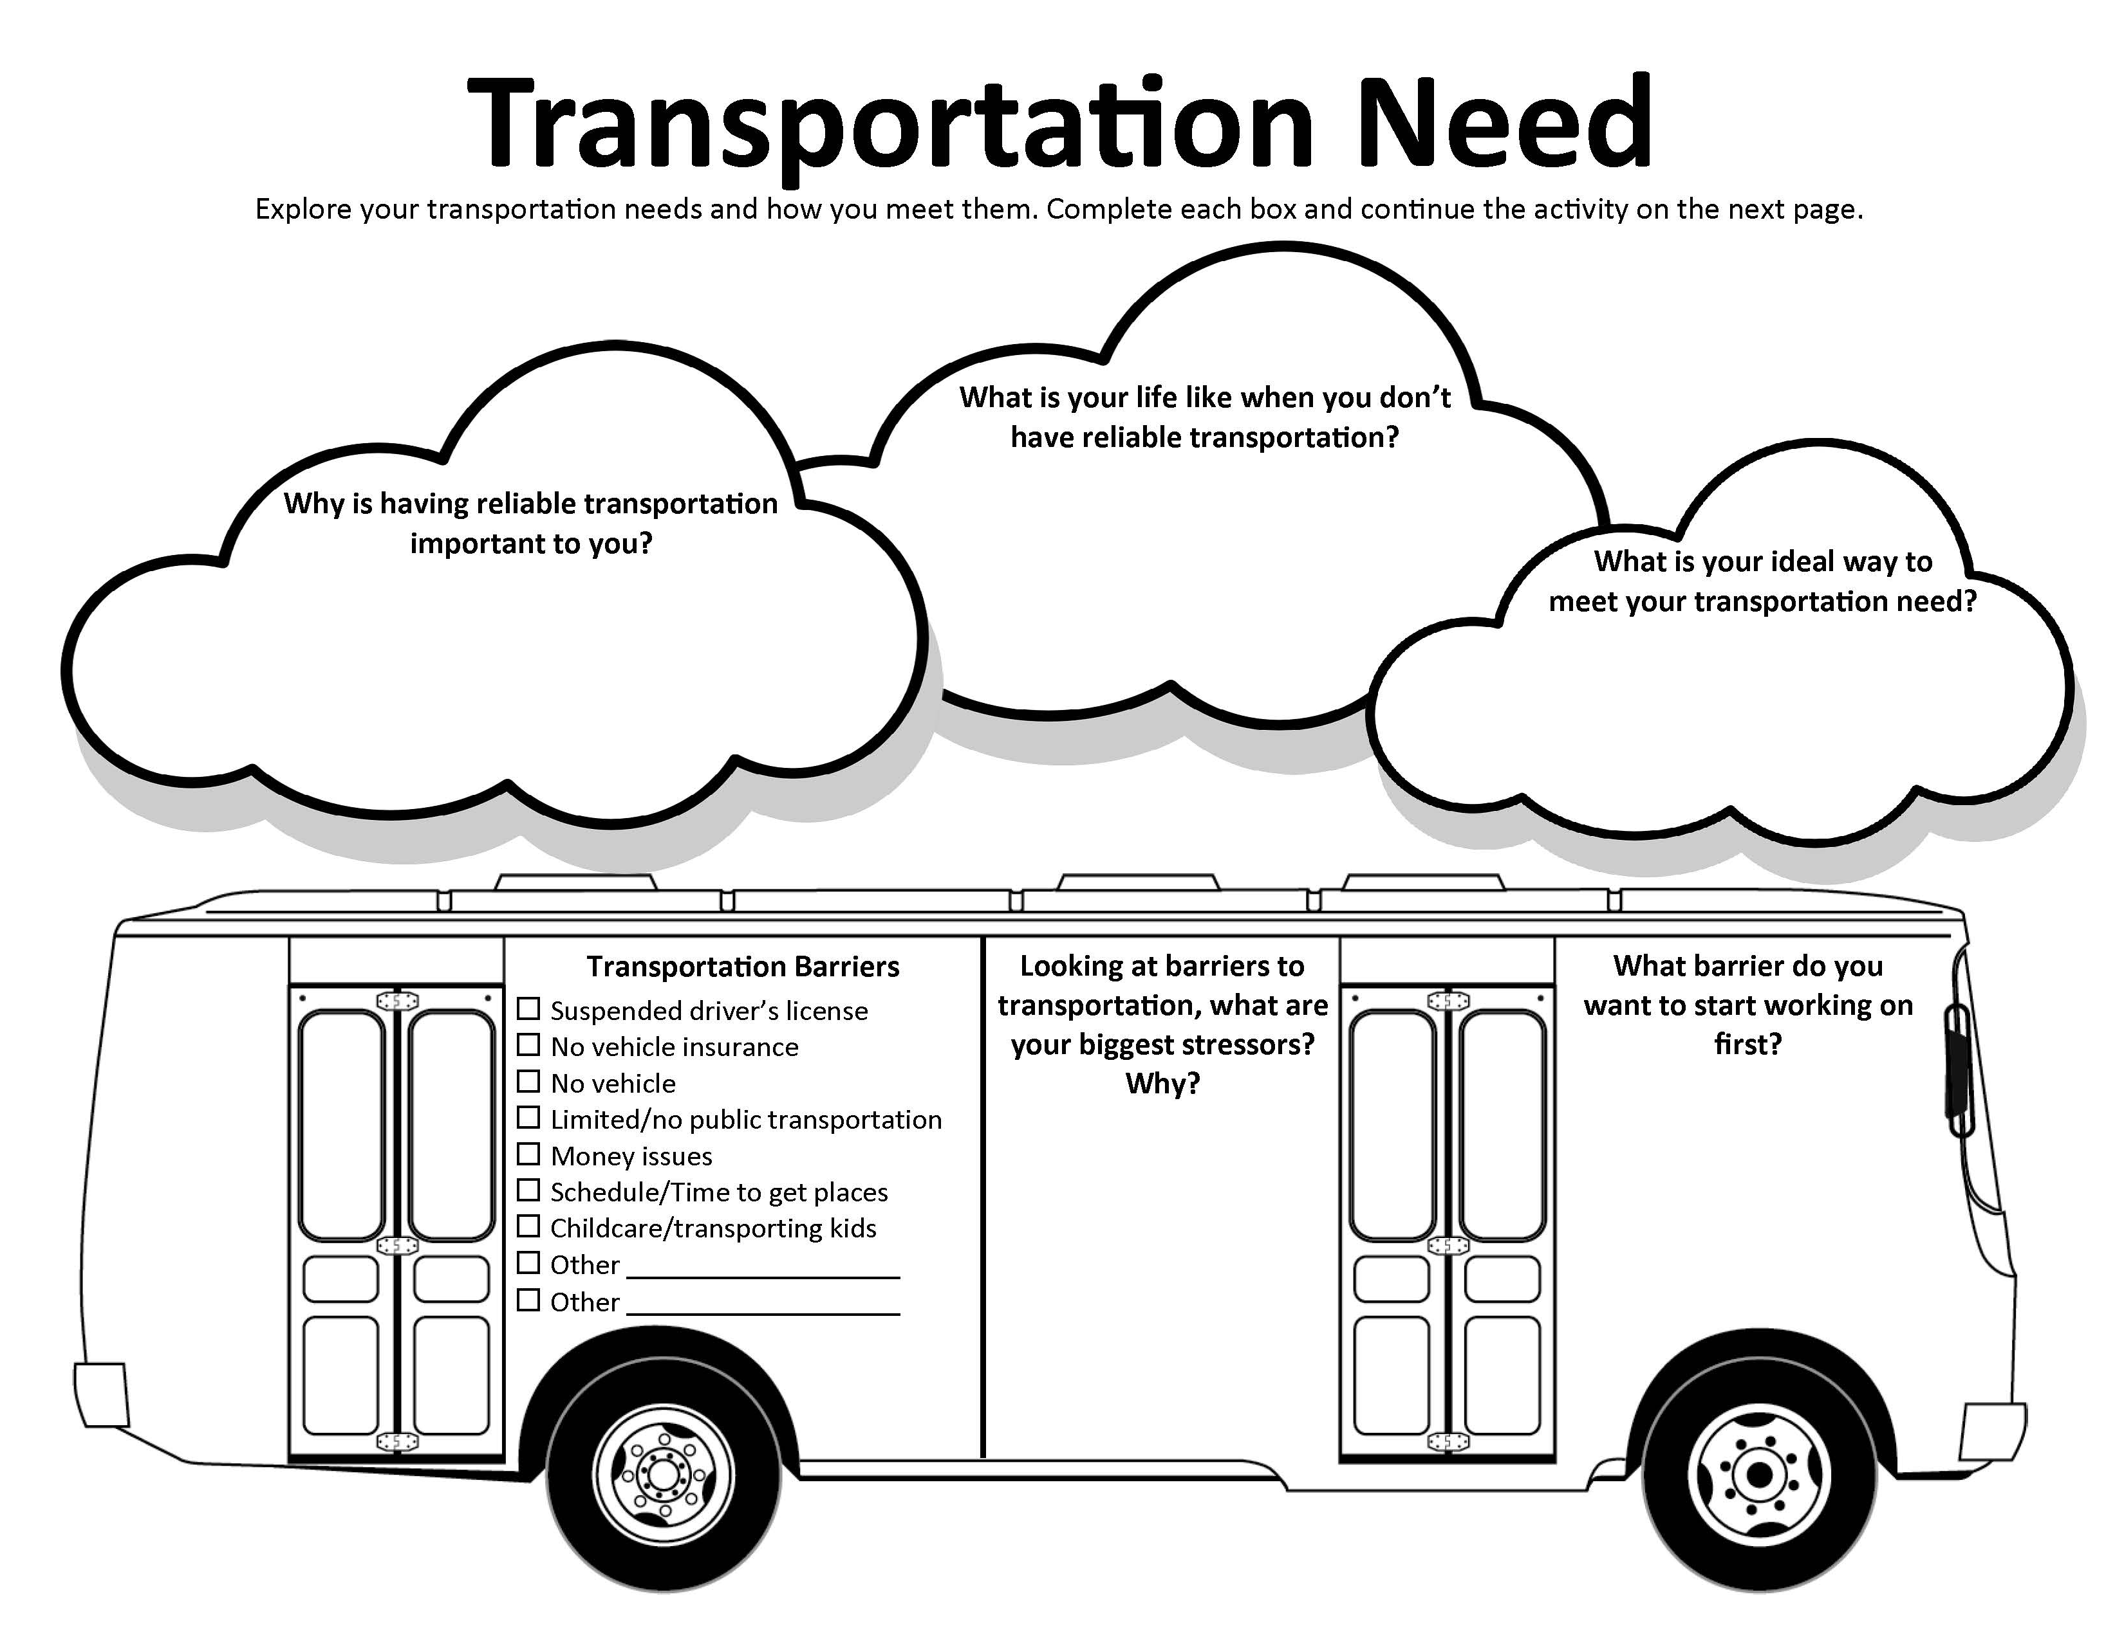

Slide 19
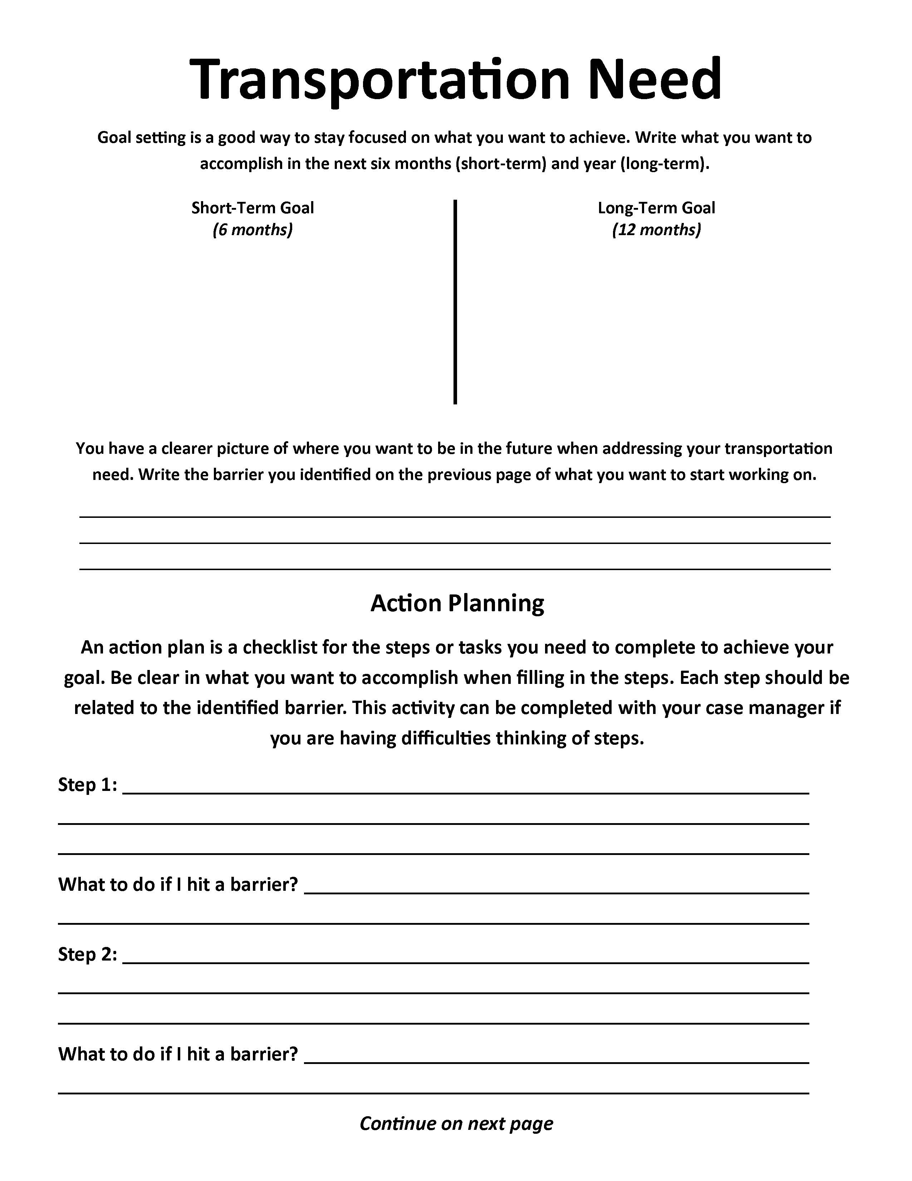

Slide 20
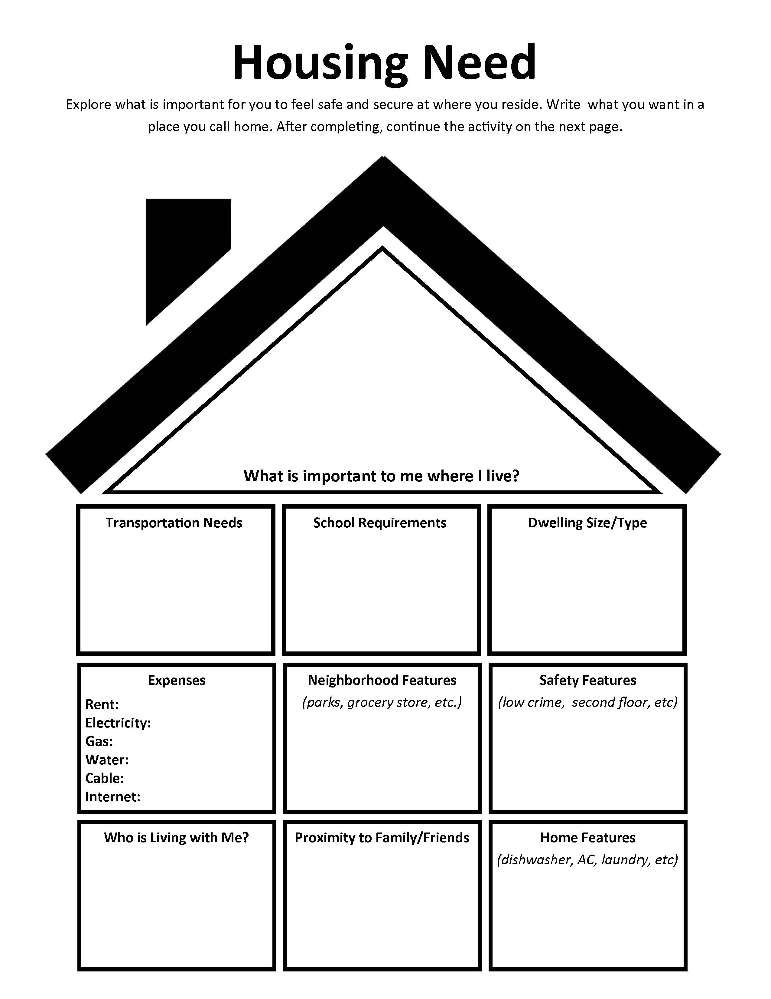

Slide 21
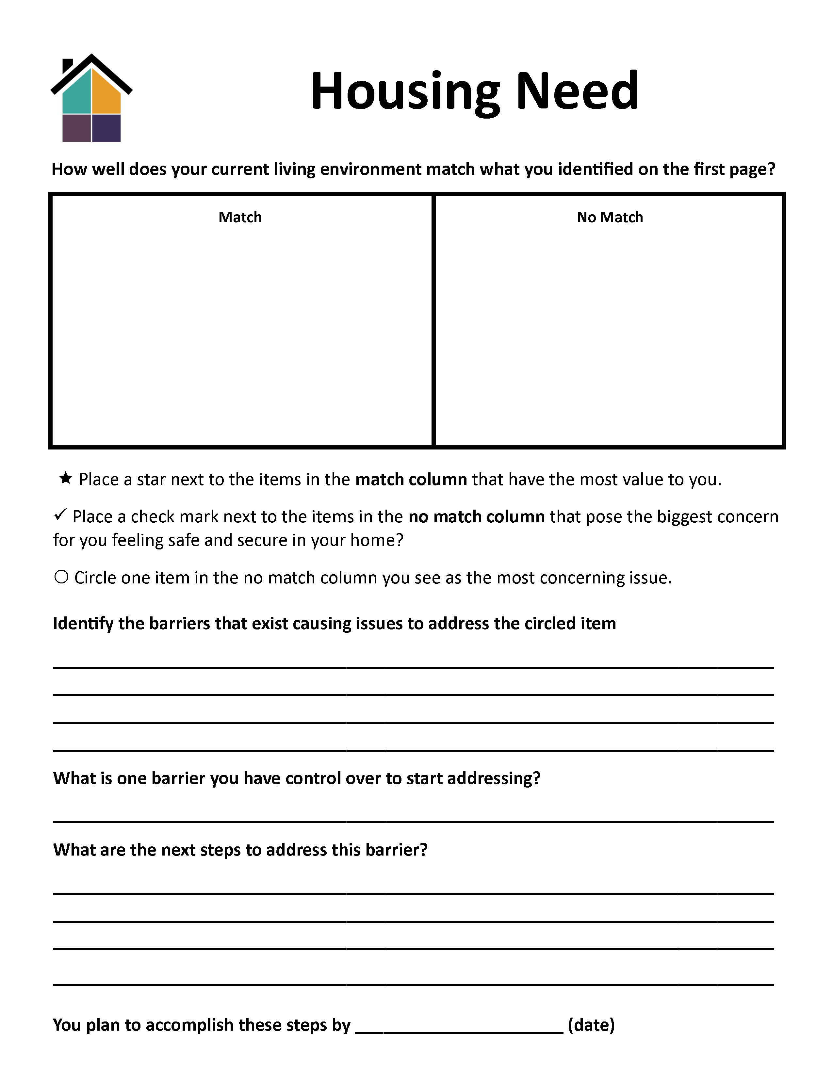

Slide 22
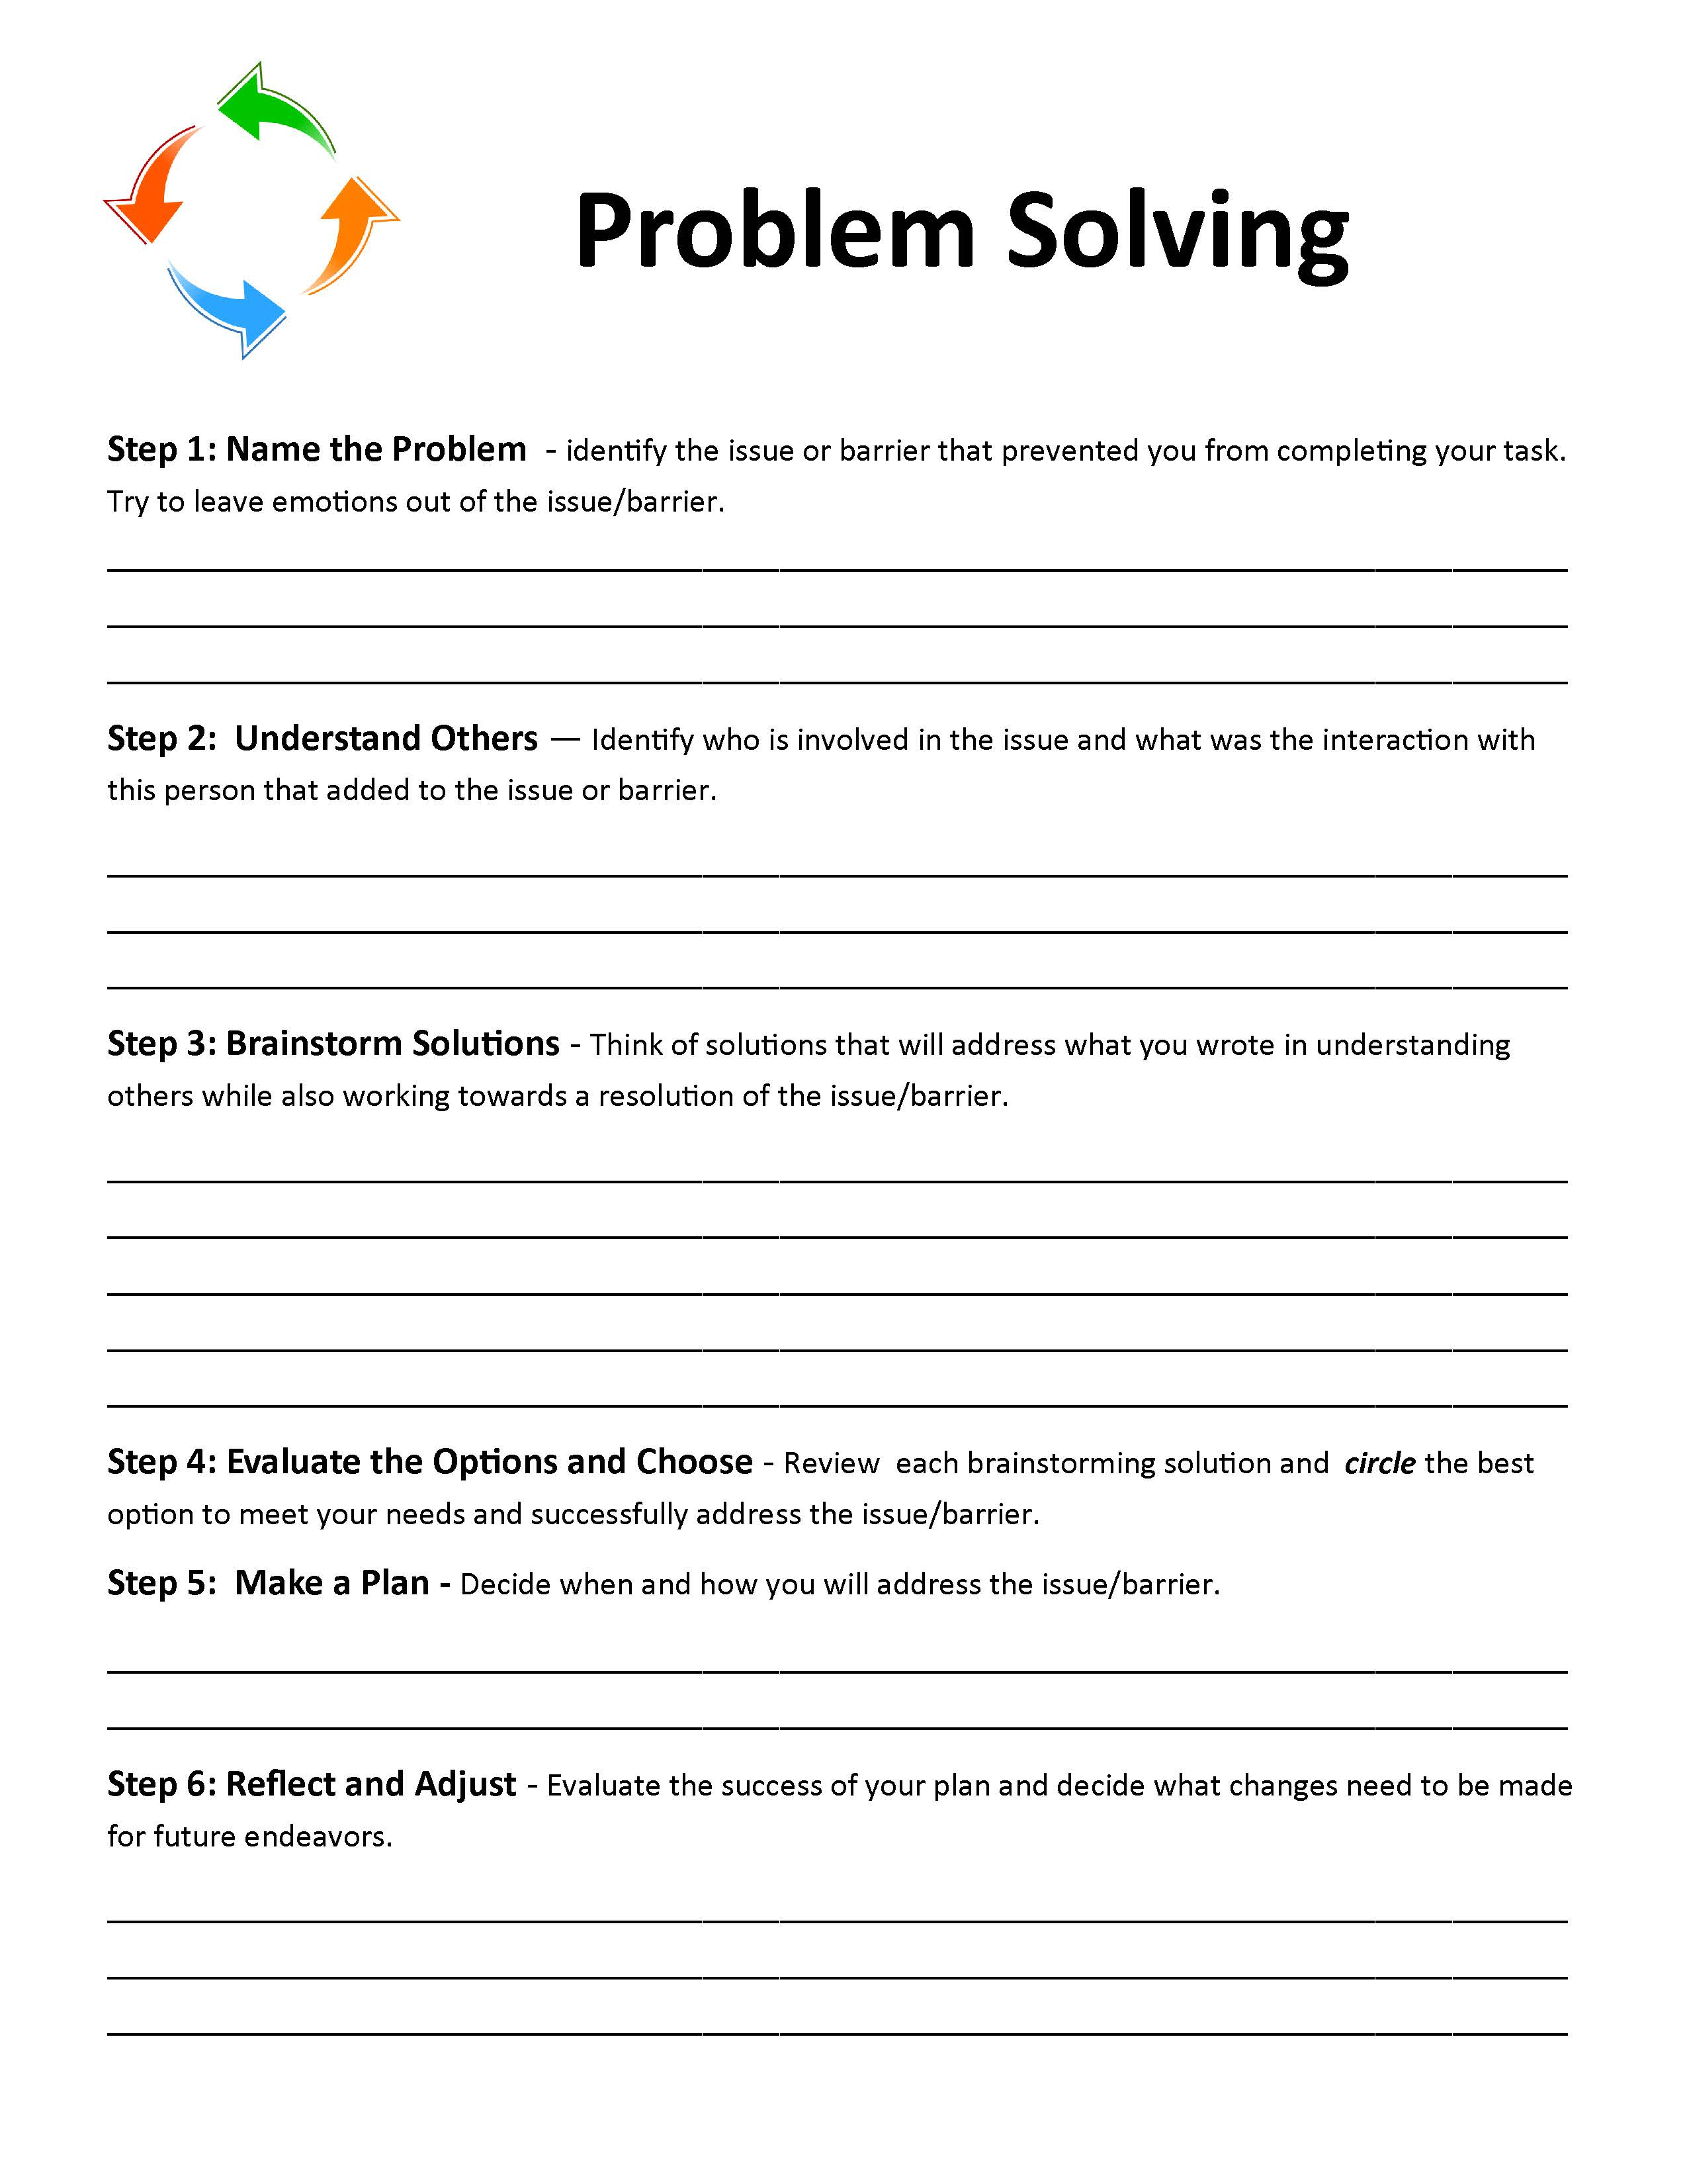

Slide 23
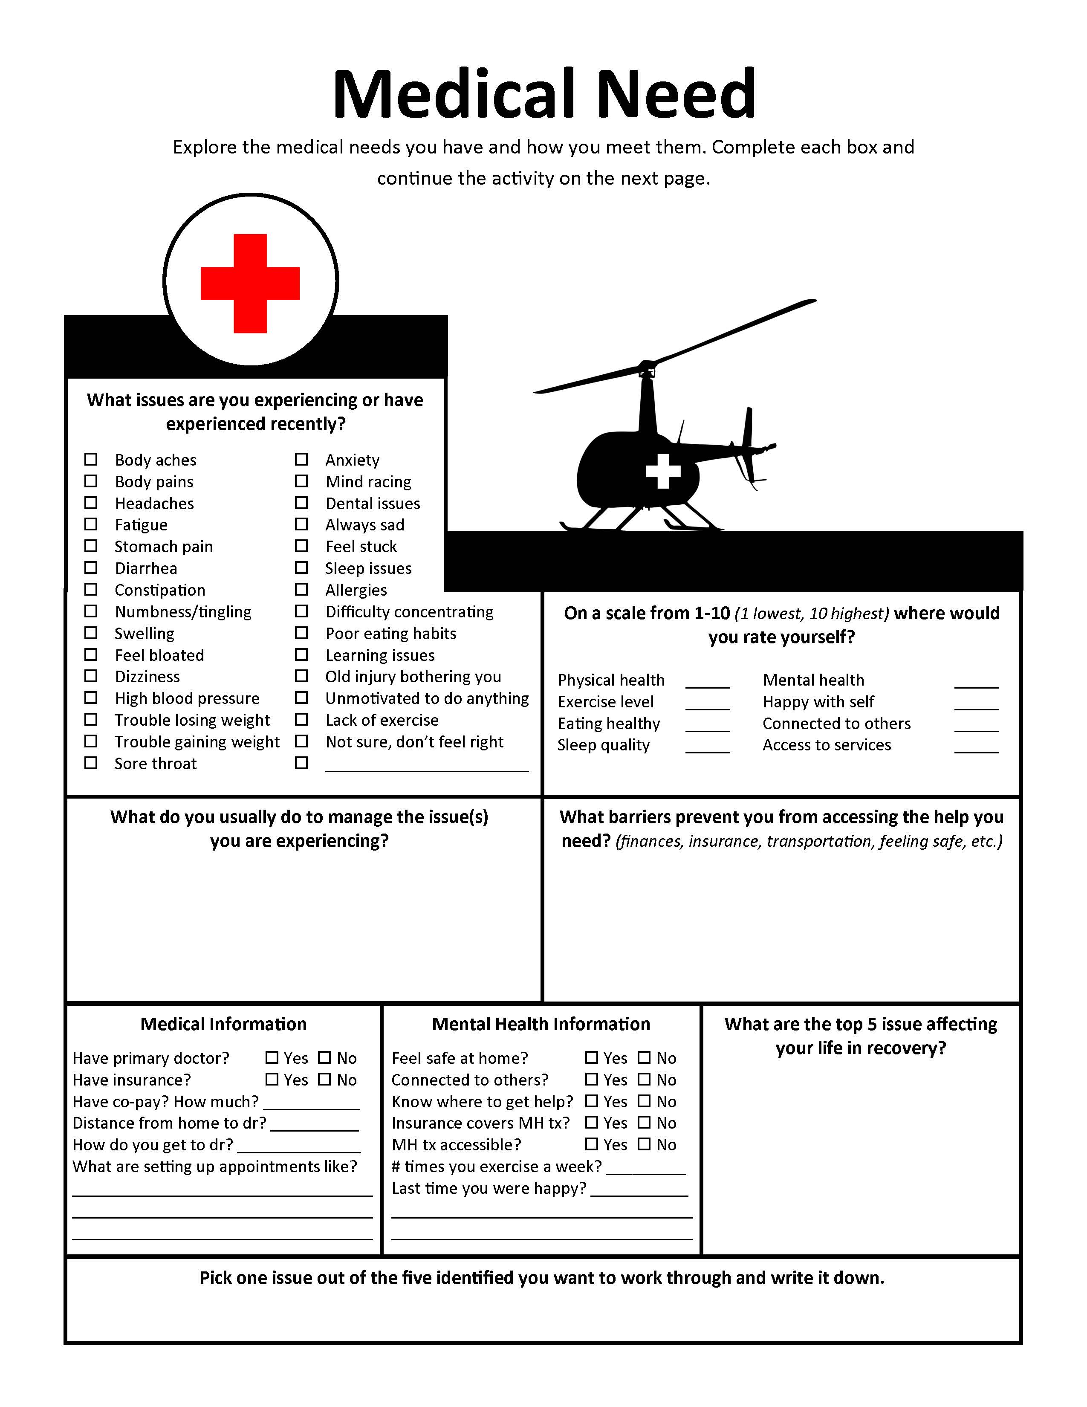

Slide 24
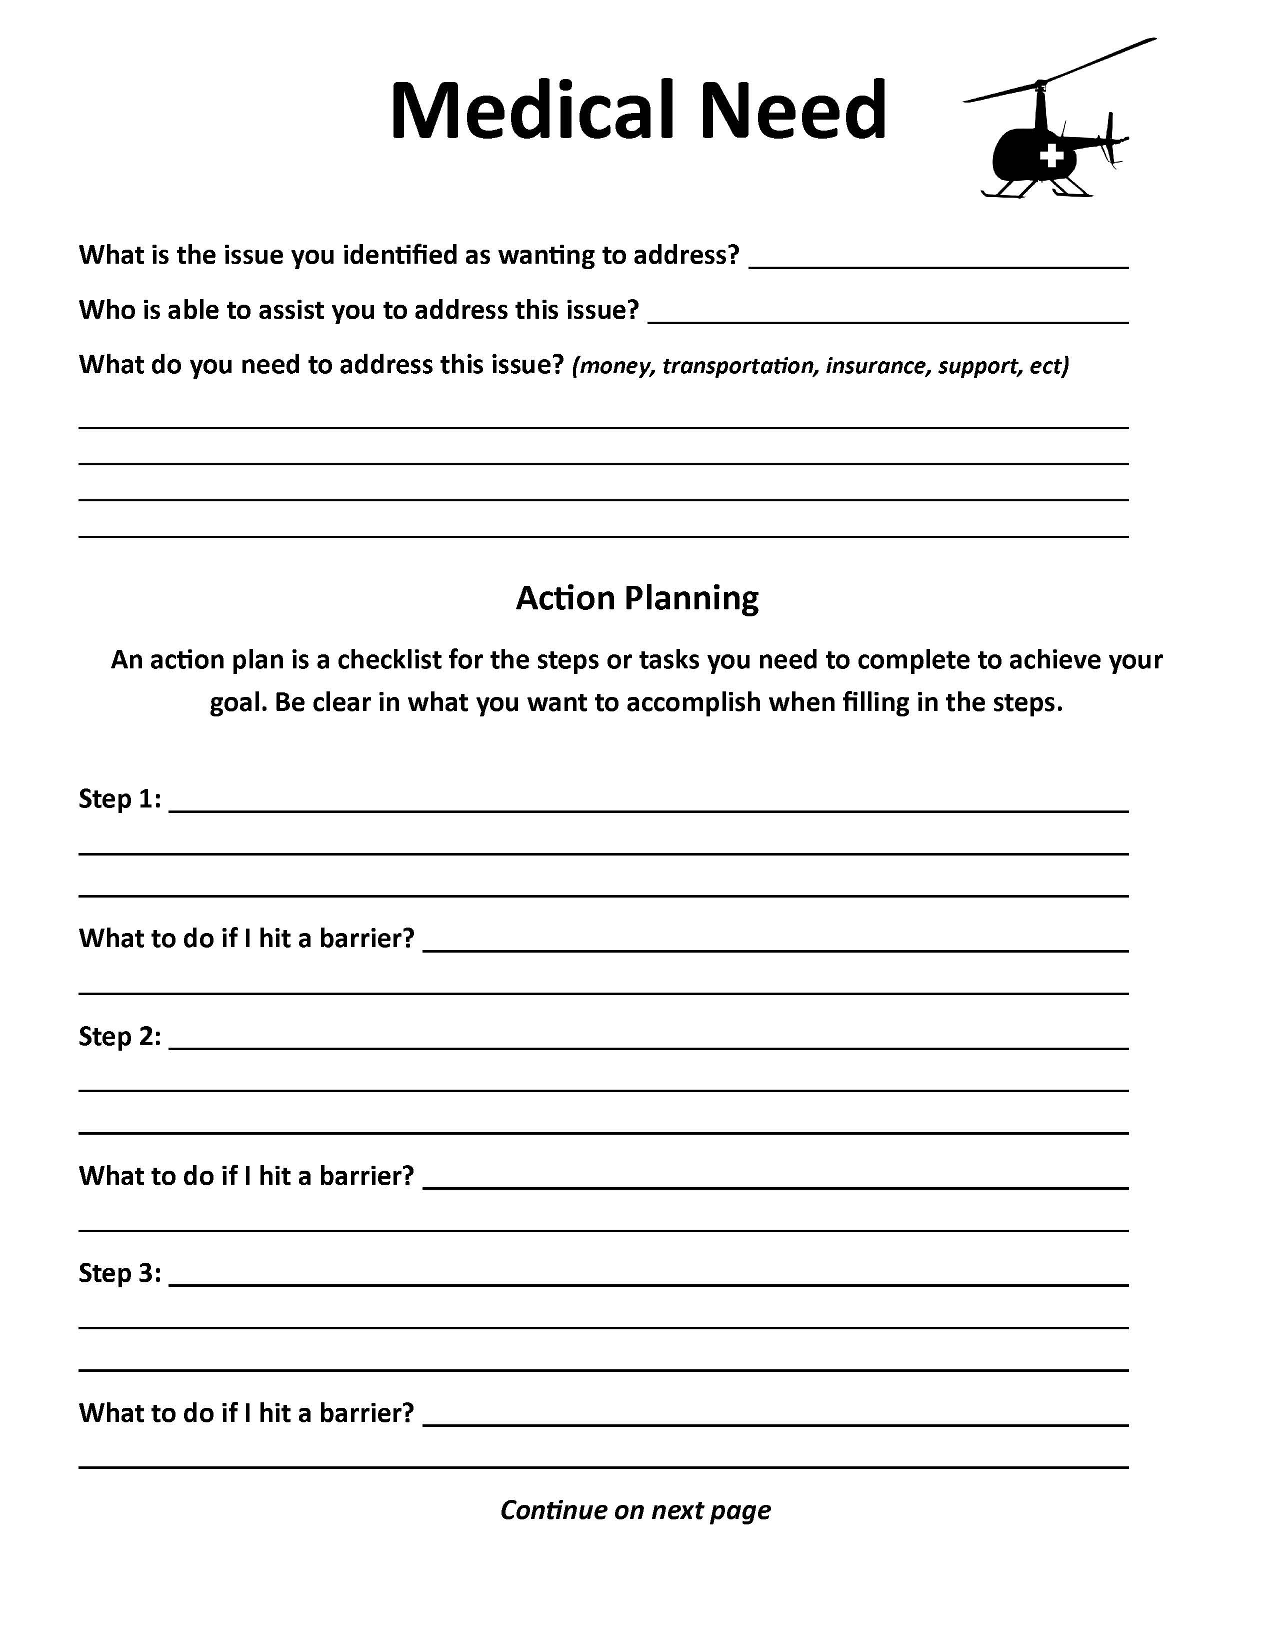

Slide 25
Phase 2
Recovery Capital
I have an intimate partner supportive of my recovery process.
I have family members who are supportive of my recovery process.
I have friends who are supportive of my recovery process.
I have people close to me (intimate partner, family members, or friends) who are also in recovery.
Notes:
In phase 2, our case planning should continue with the phase 1 physical recovery capital and begin addressing Human Capital. Human capital includes knowledge, interpersonal skills, problem solving abilities, self-awareness and self-esteem, and a sense of meaning and purpose in life. In this phase 1 and 2 a great deal is placed on community resources of utilizing CB treatments.

Slide 27
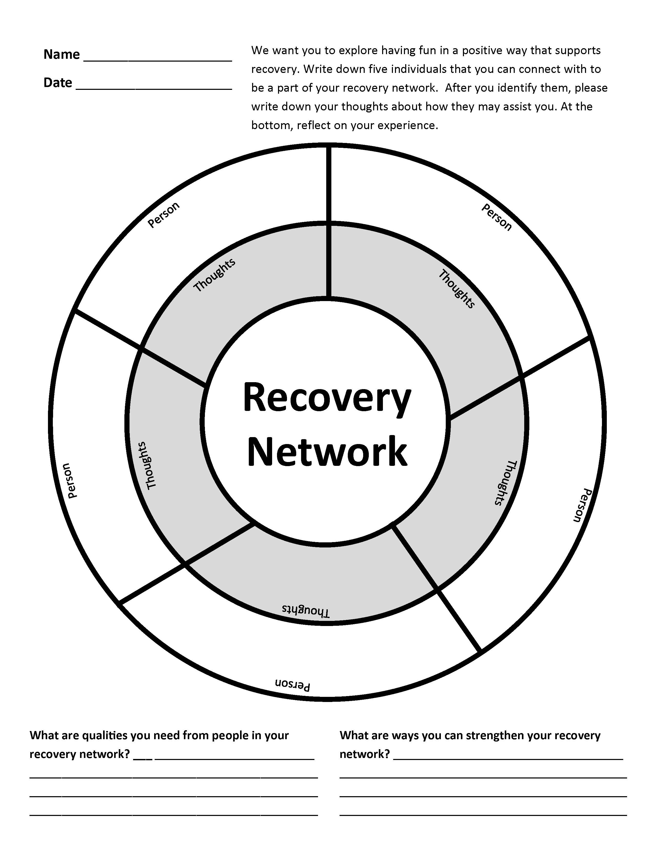

Slide 28
Phase 3
Recovery Capital
I have a professional assistance program that is monitoring and supporting my recovery process.
I am on prescribed medication that minimizes my cravings for alcohol and other drugs.
I have clothes that are comfortable, clean and conducive to my recovery activities.
I have access to recovery support groups in my local community.
I have established close affiliation with a local recovery support group.
I have a sponsor (or equivalent) who serves as a special mentor related to my recovery.
I have access to Online recovery support groups.
I have completed or am complying with all legal requirements related to my past.
Notes:
We continue to focus on human capital but expanding with a look in Community Capital. We ensure that resources in the community and agencies we are referring clients to have towards addiction and recovery. This includes a
Full continuum of treatment resources
Accessibility of resources that are diverse
Local recovery efforts and supports
Culturally prescribed and supported pathways of recovery
Recovery norms that are valued in the community
Activities for clients to begin to engage such as running clubs,

Slide 29
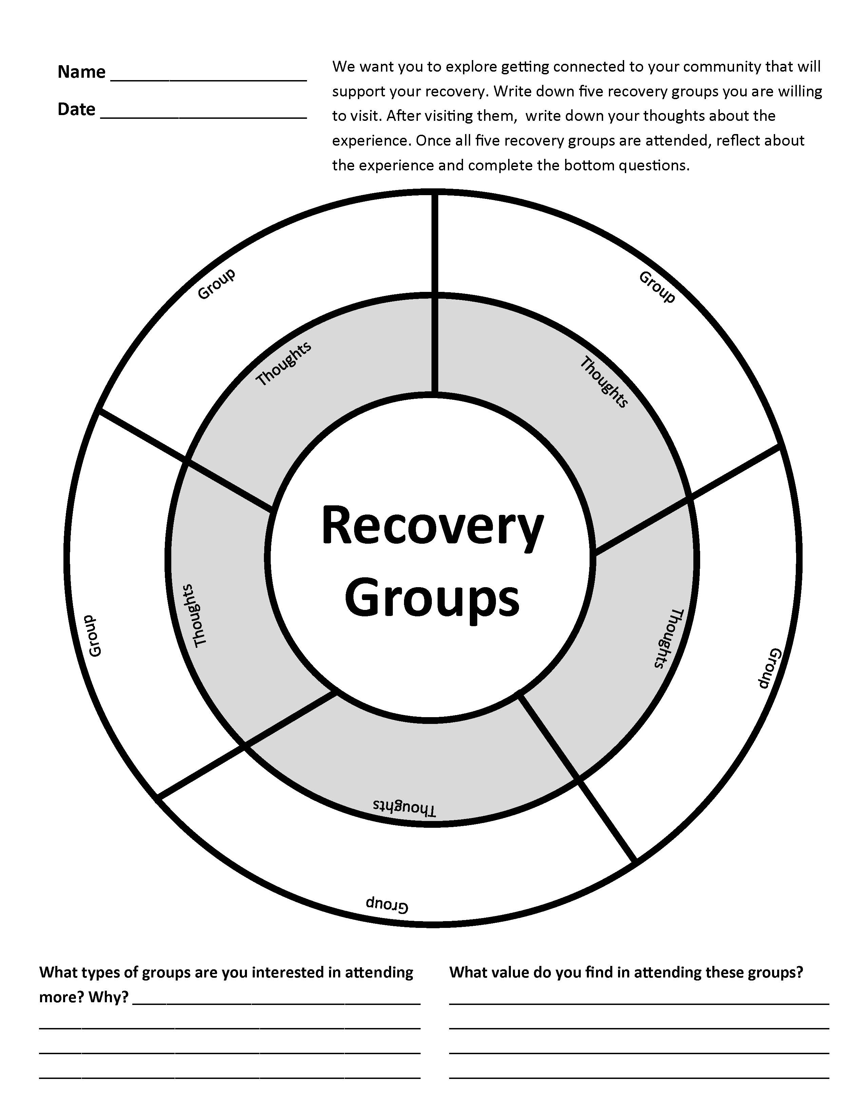

Slide 30
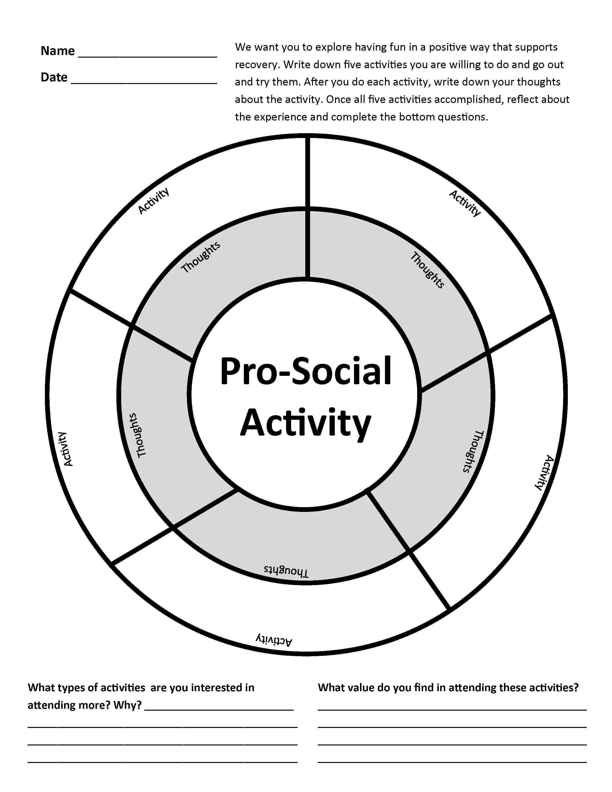

Slide 31
Phase 4
Recovery Capital
I have a stable job that I enjoy and that provides for my basic necessities.
I have an education or work environment that is conducive to my long-term recovery.
I continue to participate in a continuing care program of an addiction treatment program, (e.g., groups, alumni association meetings, etc.)
My immediate physical environment contains literature, tokens, posters or other symbols of my commitment to recovery.
I have recovery rituals that are now part of my daily life.
Notes:
Case management needs to continue to assist clients with assessing natural, community-based supports that can ensure long-term recovery for participants. Asking clients to demonstrate where they are in relation to these questions assist with preparing them for program departure and recovery planning.

Slide 32
Phase 5
Recovery Capital
I had a profound experience that marked the beginning or deepening of my commitment to recovery.
I now have goals and great hopes for my future.
I have problem solving skills and resources that I lacked during my years of active addiction
I feel like I have meaningful, positive participation in my family and community.
Today I have a clear sense of who I am.
I know that my life has a purpose.
Service to others is now an important part of my life.
My personal values and sense of right and wrong have become clearer and stronger in recent years.
Notes:
In phase 5, we are preparing participants to live without the treatment court program. Those natural supports that we have been helping them to develop, access and begin to foster new relationships were in preparation of them successfully completing the program. Commencing to this new life of recovery with tools to help them being successful. Those with strong social recovery capital have intimate partners and family members that are willing to participate in treatment with the client. There is also access to sober outlets for fellowship, activities and supports. Participants are now demonstrating an increased Human capital includes problem solving abilities, self-awareness and self-esteem, and a sense of meaning and purpose in life.

Slide 33
Recovery Management
Post Program Support
Return to treatment sooner
Receive more treatment
Reduce use and problems
Increase days abstinent
M.L. Dennis and Christy K. Scott (2012)
Notes:
We are dealing with a chronic disorder. Cancer, diabetes, hypertension, asthma include ongoing management protocols. There is treatment and then follow-up appointments that include blood work, diet and exercise, and ongoing check-ins. We need to include similar services with the individuals we serve. The Adult Drug Court Best Practice Standards state that Participants prepare a continuing-care plan together with their counselor to ensure they continue to engage in prosocial activities and remain connected with a peer support group after their discharge from the Drug Court. For at least the first ninety days after discharge from the Drug Court, treatment providers or clinical case managers attempt to contact previous participants periodically by telephone, mail, e-mail, or similar means
to check on their progress, offer brief advice and encouragement, and provide referrals for
additional treatment when indicated.
We have a short window of time to meet the needs of the clients. The RMC study by Mike Dennis and Christy Scott showed that by conducting “Recovery Management Checkups” –benefits are return to treatment sooner, receive more treatment , reduce use and problems and increase days abstinent. The greatest reduction were for individuals who that reported earlier age of onset of substance use or greater involvement with crime or violence.

Slide 34
Recovery Management
Post Program Support
Phone call
Mail
Recovery Coaches
Sponsors
Peer Support Specialist
Use Technology
Notes:
We are dealing with a chronic disorder. Cancer, diabetes, hypertension, asthma include ongoing management protocols. There is treatment and then follow-up appointments that include blood work, diet and exercise, and ongoing check-ins. We need to include similar services with the individuals we serve. The Adult Drug Court Best Practice Standards state that Participants prepare a continuing-care plan together with their counselor to ensure they continue to engage in prosocial activities and remain connected with a peer support group after their discharge from the Drug Court. For at least the first ninety days after discharge from the Drug Court, treatment providers or clinical case managers attempt to contact previous participants periodically by telephone, mail, e-mail, or similar means
to check on their progress, offer brief advice and encouragement, and provide referrals for
additional treatment when indicated.
We have a short window of time to meet the needs of the clients. The RMC study by Mike Dennis and Christy Scott showed that by conducting “Recovery Management Checkups” –benefits are return to treatment sooner, receive more treatment , reduce use and problems and increase days abstinent.

Slide 35
Recovery Management
Post Program Support
Review Continuing Care Plan
Exercise
Family Engagement
Employment
Pro-social Activities
Struggles/Coping/Joys
Notes:
These are things to discuss with the individuals. Keep in mind, we have a short amount of time to cover all of the topics per phase and revisiting issues as clients' programs. After leaving the program, life does not stop. You have achieved so much but life is a continuing struggle

Slide 36
Recovery Management
Post Program Support
Every 30 days
90 days
120 days
1 year to 2 years or longer
Notes:
You have achieved so much but life is a continuing struggle

Slide 37
Thanks
Carolyn Hardin
chardin@allrise.org

