Slide 1
Gun Lake Tribe Health and Human Services Neshnabe Perspective on Mental Health & Wellness
Rebecca Werner, MD, GLT Physician
James "Bud" Day, GLT Language and Culture Director
October 30, 2024

Slide 2
Learning Objectives
Identify
Identify cultural considerations when working with American Indians/Alaska Natives
Understand
Understand Person Centered Care approaches within Tribal Health Centers
Identify
Identify how individual implicit bias can impact delivery of care within Tribal Health Centers

Slide 3
Cultural Norms
Family structure in Tribal communities
Faith and belief in Traditional Medicine
Role of prayer and ceremony
Assumptions
Body language and gestures
Notes:
Provider positioning in the room with elders.

Slide 4
Historical Trauma
Definition of Historical Trauma
Boarding School era
Generational Trauma effects
Fairness and responsibility
Notes:
Pause and ask for questions

Slide 5
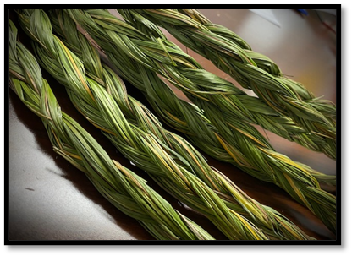
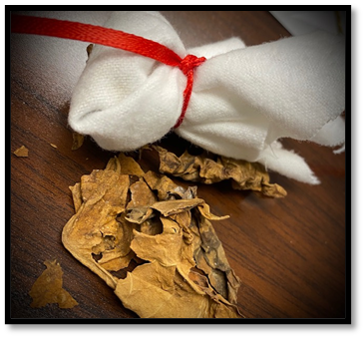
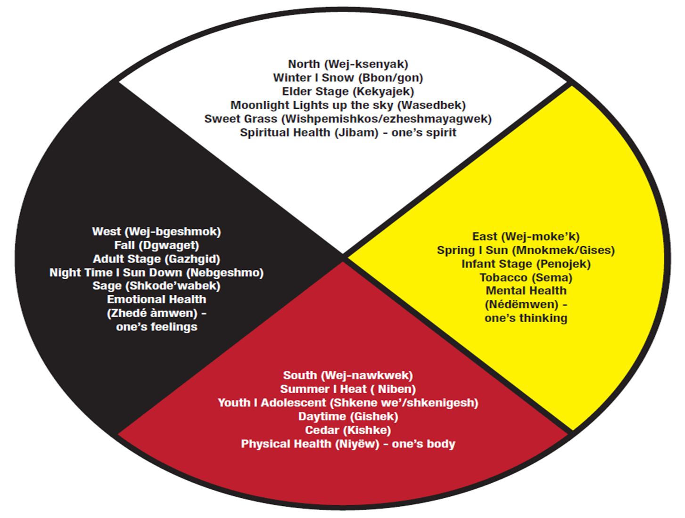
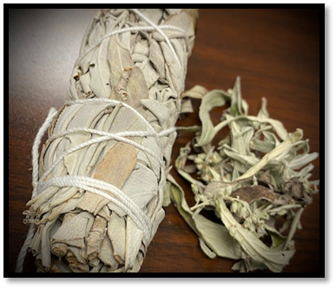
Four Directions & Medicine Teachings

Slide 6
Sweet Grass Braids
Notes:
Physical Representation of MIND BODY SPIRIT

Slide 7
Health & Wellness
Health is NOT merely the absence of disease
Balance of mind, body and spirit
Physical, mental and social well-being
DIFFERENT for everyone!
Notes:
Graphic/Picture?
WHO: WHO's constitution states that health is "a state of complete physical, mental, and social well-being and not merely the absence of disease or infirmity"
In Western medicine, we practice evidence based care, and follow clinical guidelines. However, if everyone's balance is different, they will follow a different path to wellness. This is a process, not necessarily a destination!

Slide 8
Cultural Identity
Individual
Spirit Name
Family
Clanships
Community
Where you live
Tribe Nation
Who you belong to
Notes:
Name, clan, community, tribe, Indian country

Slide 9
Person Centered Care
Focuses on treating patients with dignity and respect and involving them in their health care decisions.
Based on the idea that a person's preferences, needs, and values should guide clinical decisions.
Individualized care/wellness plans
Compassionate listening
Supporting
Sharing information and sharing in the decision-making process.
Contrast with Physician/provider centered care
Notes:
Some elements of PCC include:
Active listening
Open-ended questions
Reflective conversations
Empathy
Shared goal-setting
Understanding individual preferences
CMS:
"Care that's guided and informed by patients' goals, preferences, and values. Success measured by patient-reported outcomes. Integrated and coordinated care across health systems, providers, and care settings. Managing chronic and complex conditions."

Slide 10
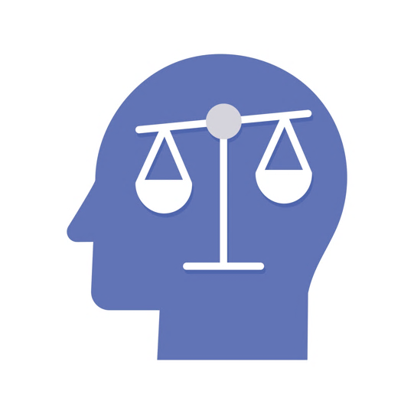
Provider Bias/Stigma
Implicit bias related to AI/AN patients
Stereotypes :
Negative: Non-compliant, resistant, Diabetes, Alcohol use D/O
Positive: Resilient
Cultural misunderstanding
Care adversely affected
Notes:
Examples:
Recent patient with liver failure.
Time/promptness.
Eye contact
Tribal health center is safe space; culturally safe space.

Slide 11
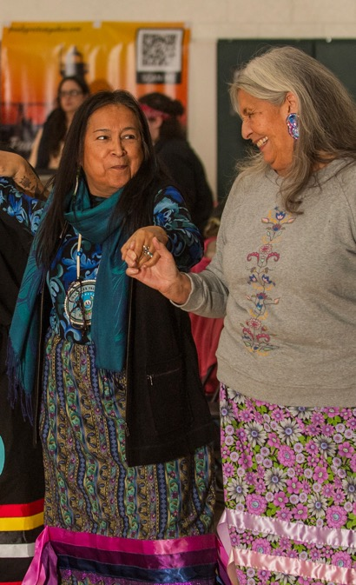
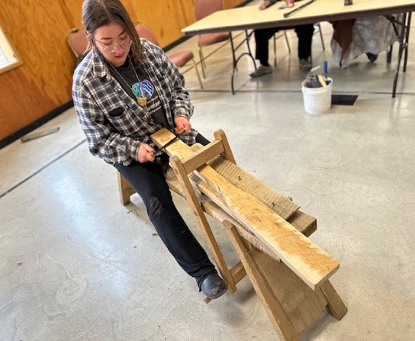
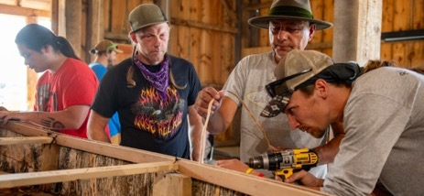
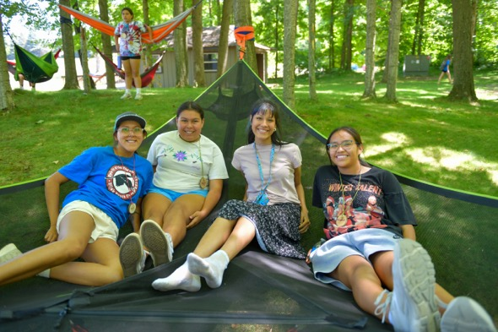
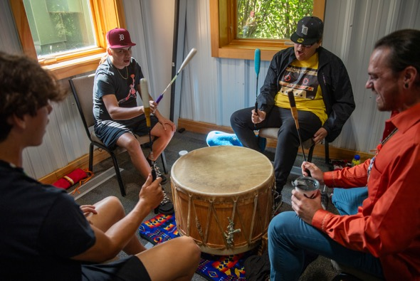
Mno Bmaadziwin
"Good way of living"

Slide 12
Miigwech (Thank You)
Questions?

